Slide 1
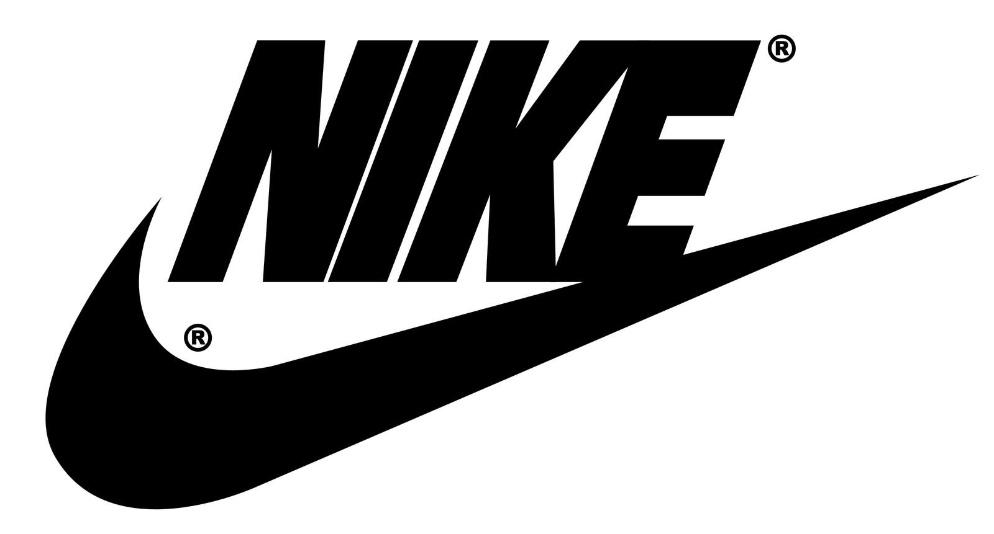
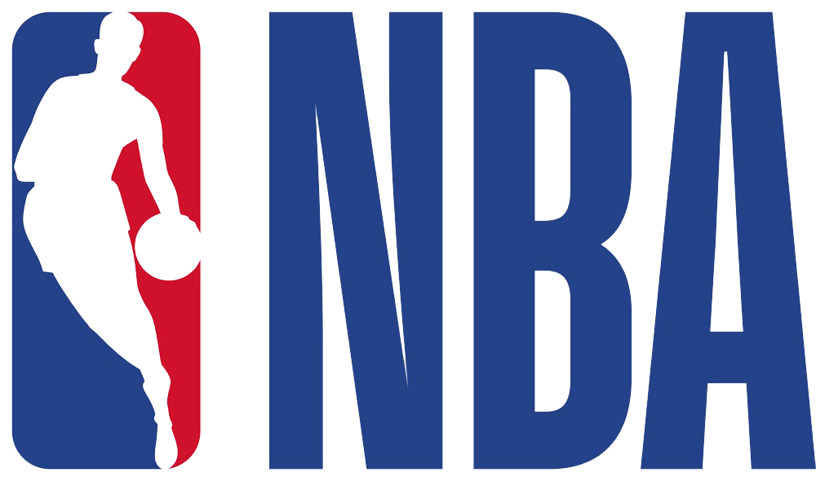
Strategizing brand deals with
top 3 athletes based on twitter fan engagement.

Slide 2
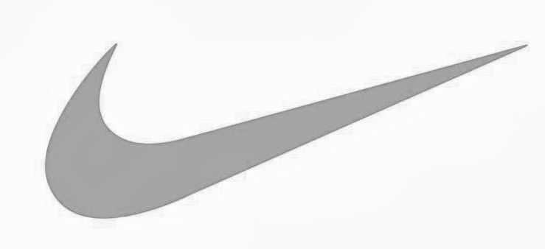
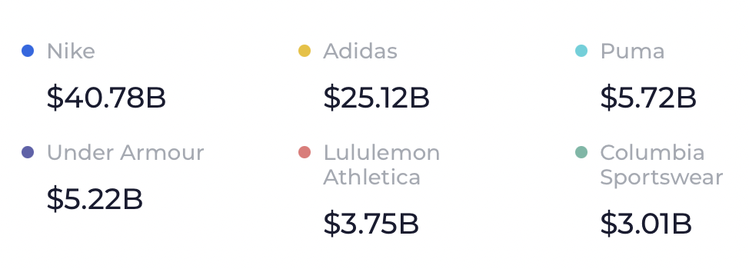
X
BUSINESS OVERVIEW
Nike and its affiliated brands control more than 90 percent of the U.S. basketball shoe market at retail.
Nike has a 41.14% total market share in the athletic brands segment.
In North America, EMEA and APLA, approximately 90 percent of
physical owned stores were closed during the fourth quarter with
stores gradually reopening at different paces in each country
beginning in mid-May.
NIKE Market Share VS Athletic Brands

Slide 3

X
FINANCES 2020
$14.484 billion of Nike's revenue in 2020 was from North America.
Nike's digital sales reached $5.5 billion, up from $3.8 billion in f2019.
Revenues for Converse were $563 million, up 2 percent on a currency-neutral basis, mainly driven by strong demand in Europe and in digital, globally.
2019
39Bn
37Bn
2020
Revenue delta due to Covid 19

Slide 4
X
Nike has been a marketing partner of the NBA since 1992!
Giannis Antetokounmpo earns an estimated $10 million a year from his Nike sneaker deal.
Kevin Durant earns an estimated $26 million a year from his sneaker deal with Nike.
Lebron James earns an estimated $32 million a year from his sneaker deal with Nike.

Slide 5
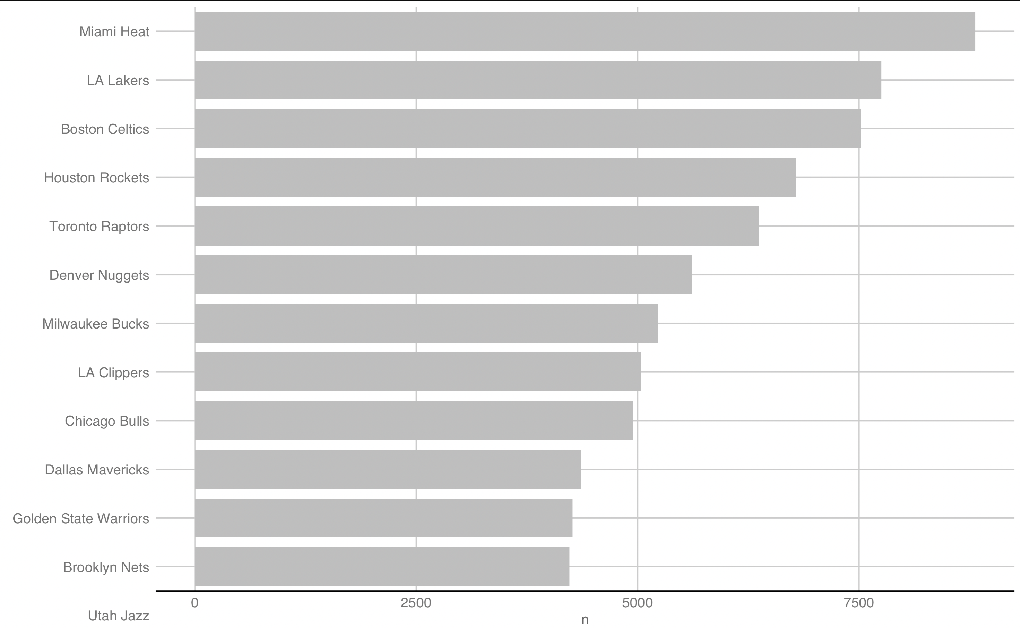
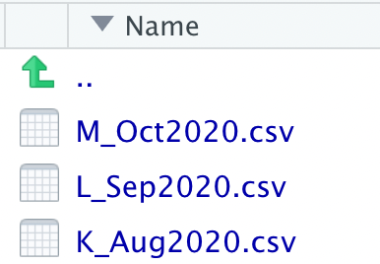
X
August 15, 2020 (Play-in game)
August 17 – September 27, 2020 (Playoffs)
September 30 – October 11, 2020 (Finals)

Slide 6
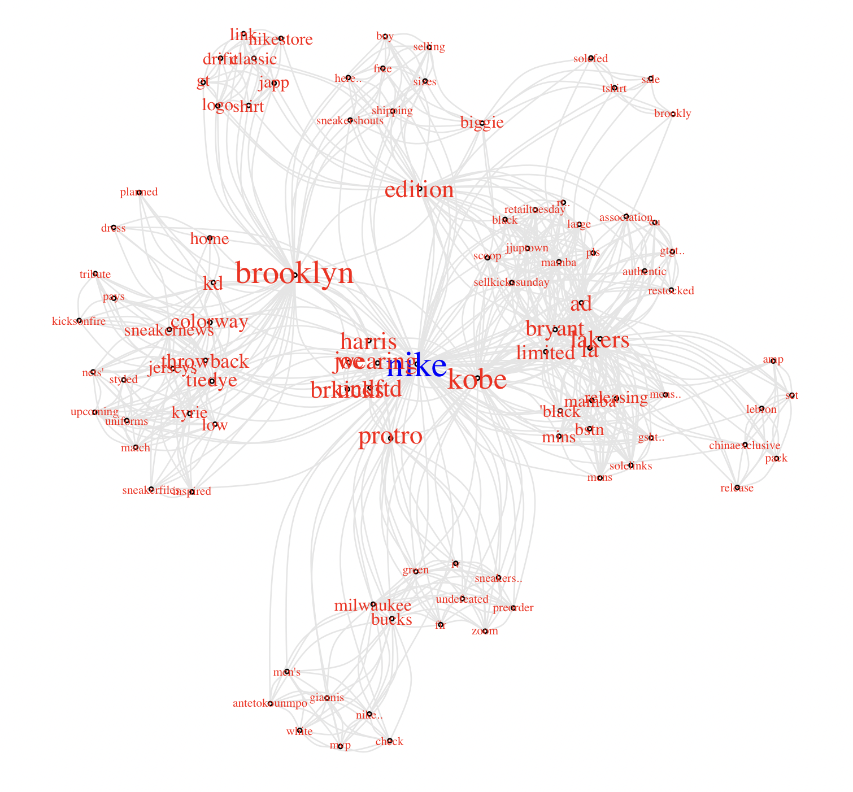
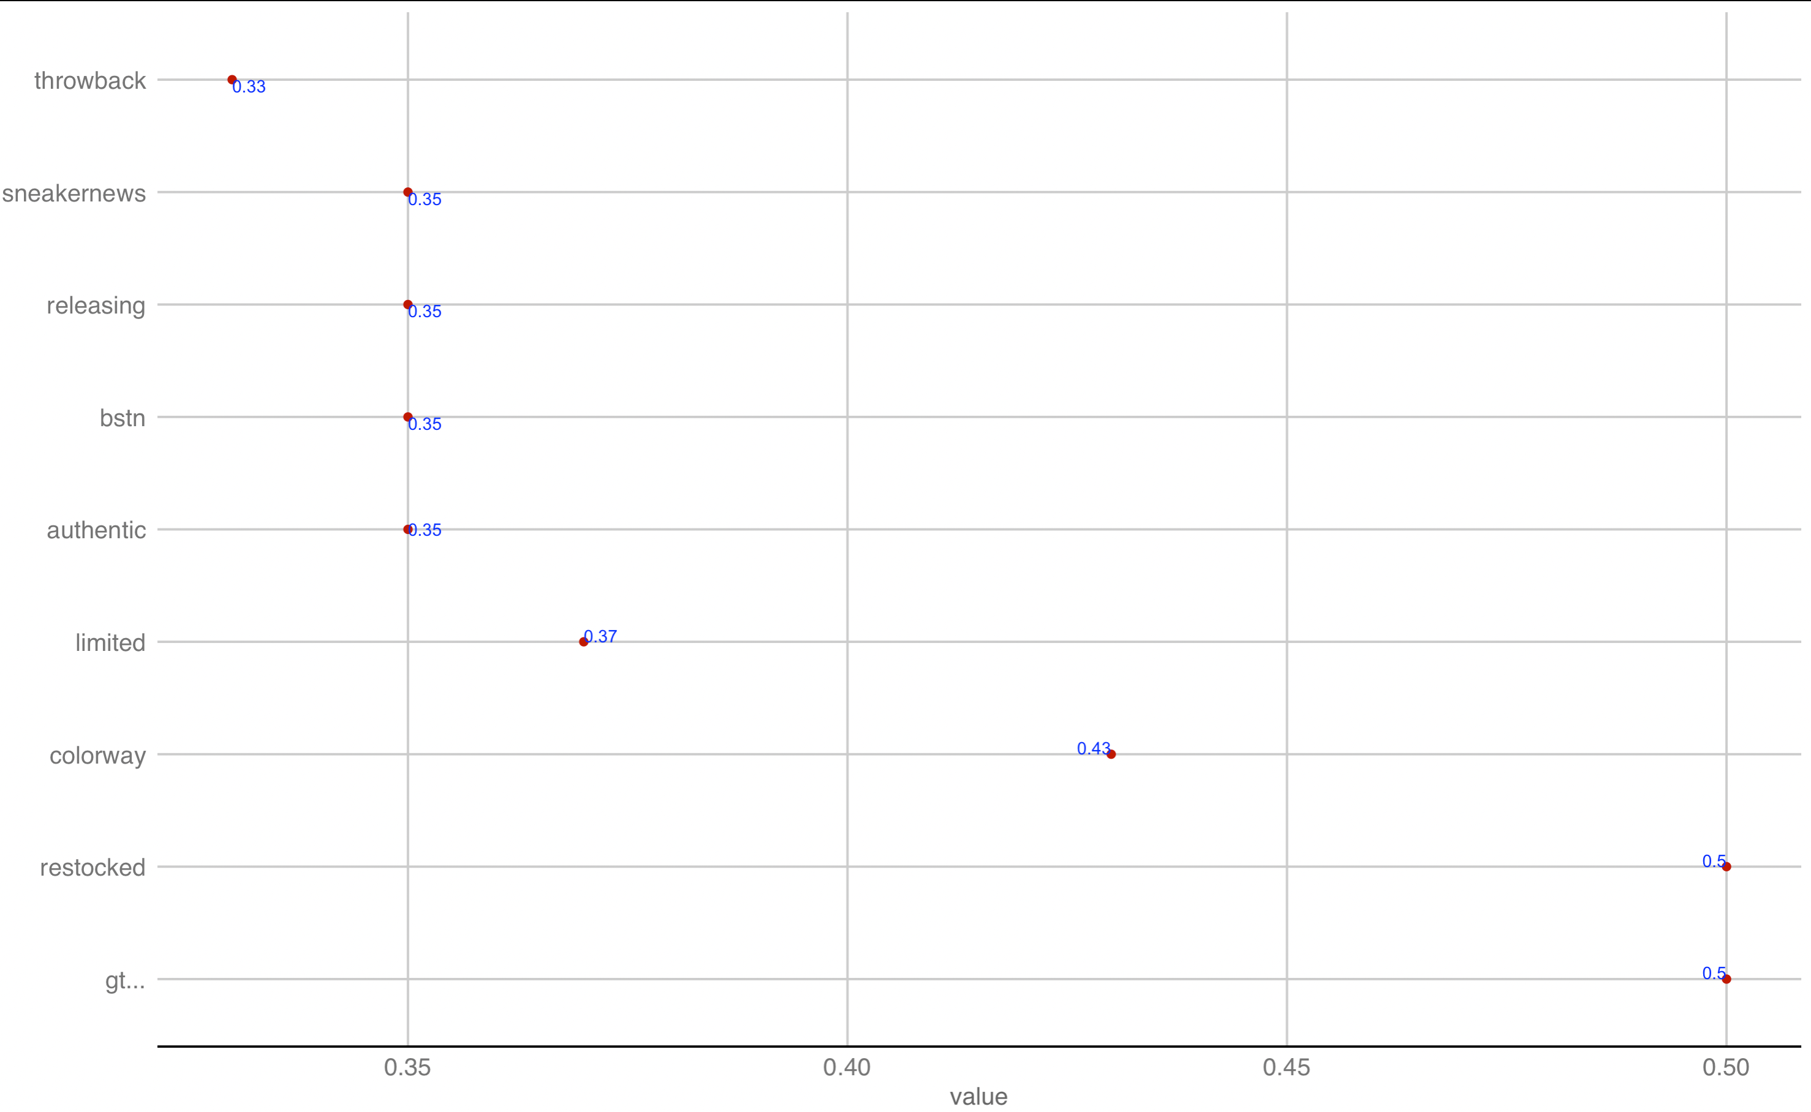
X
HIGHEST ASSOCIATIONS

Slide 7
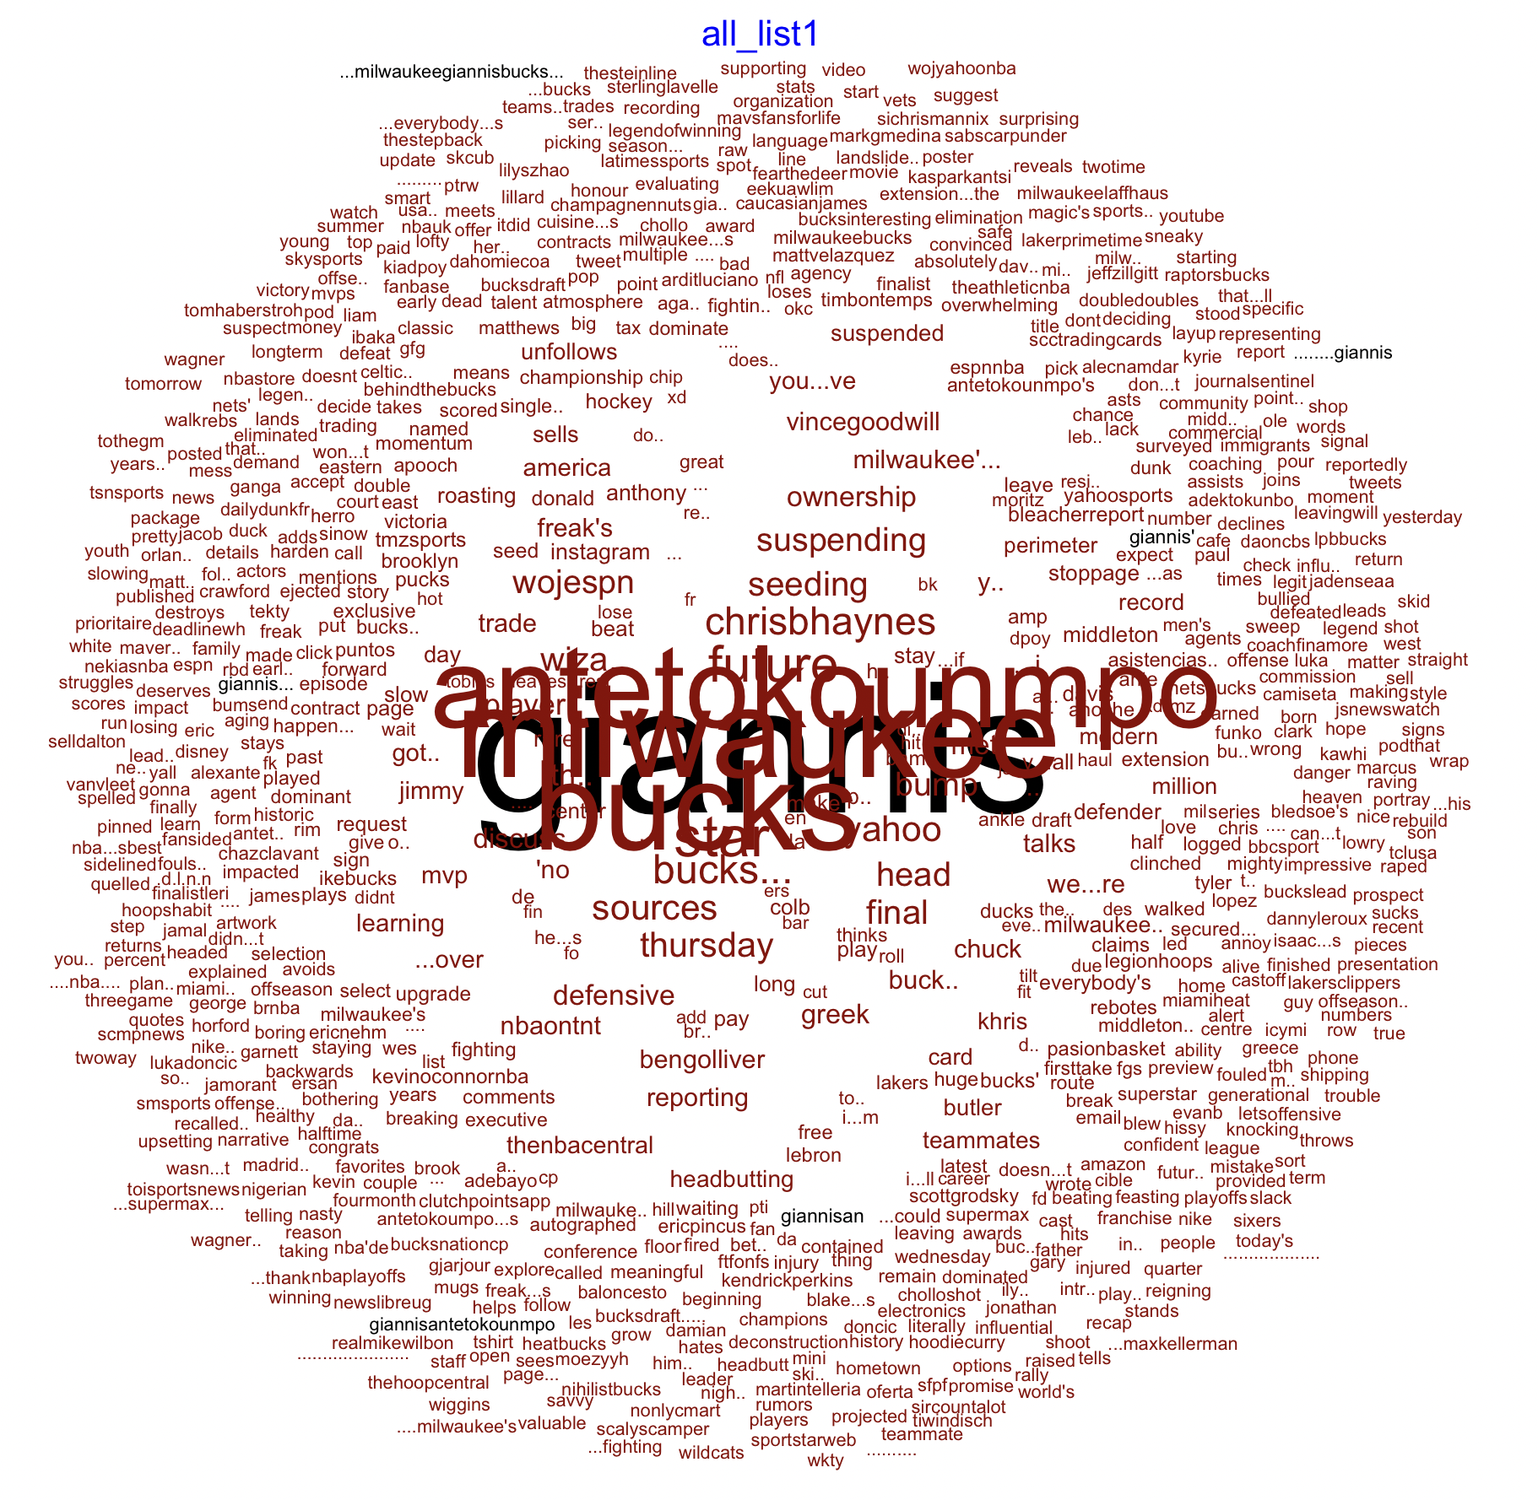
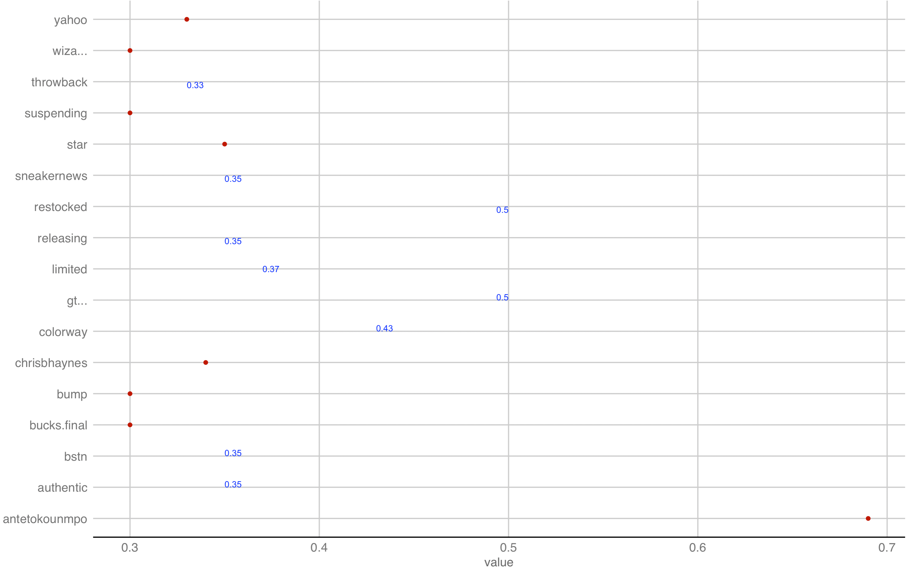
X
HIGHEST ASSOCIATIONS
Giannis Antetokounmpo

Slide 8
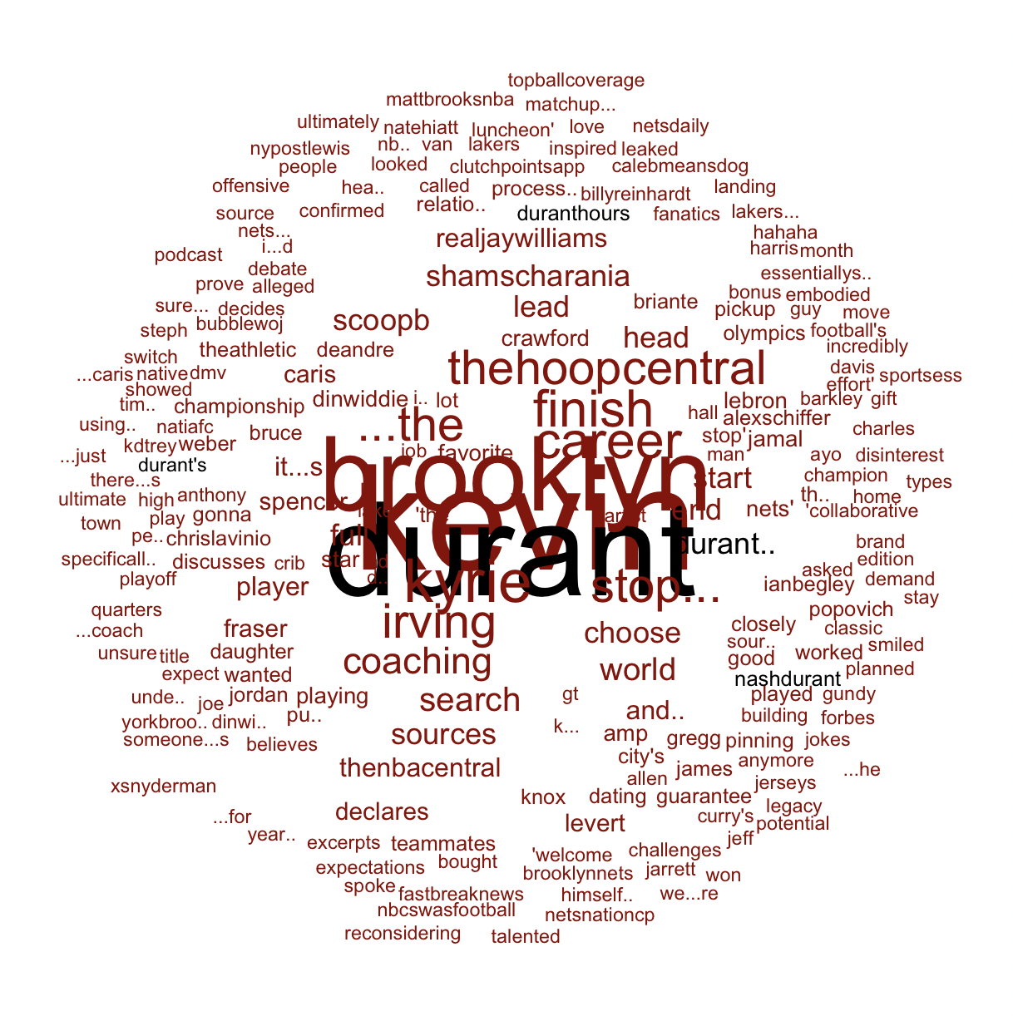
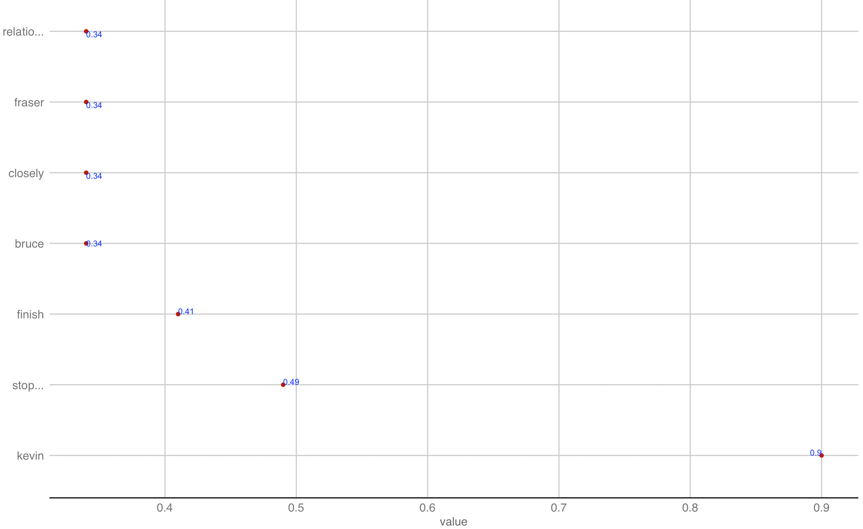
X
Kevin Durant
HIGHEST ASSOCIATIONS

Slide 9
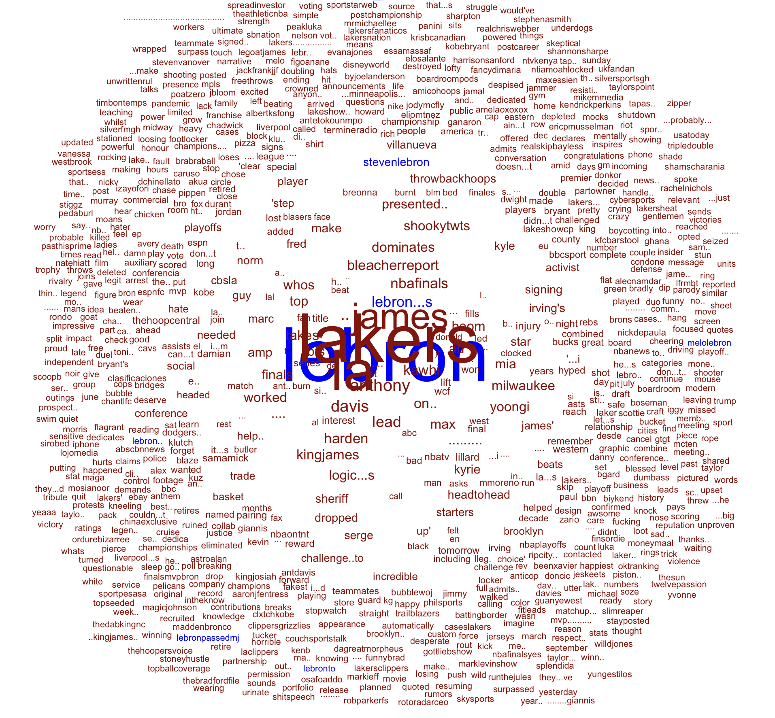
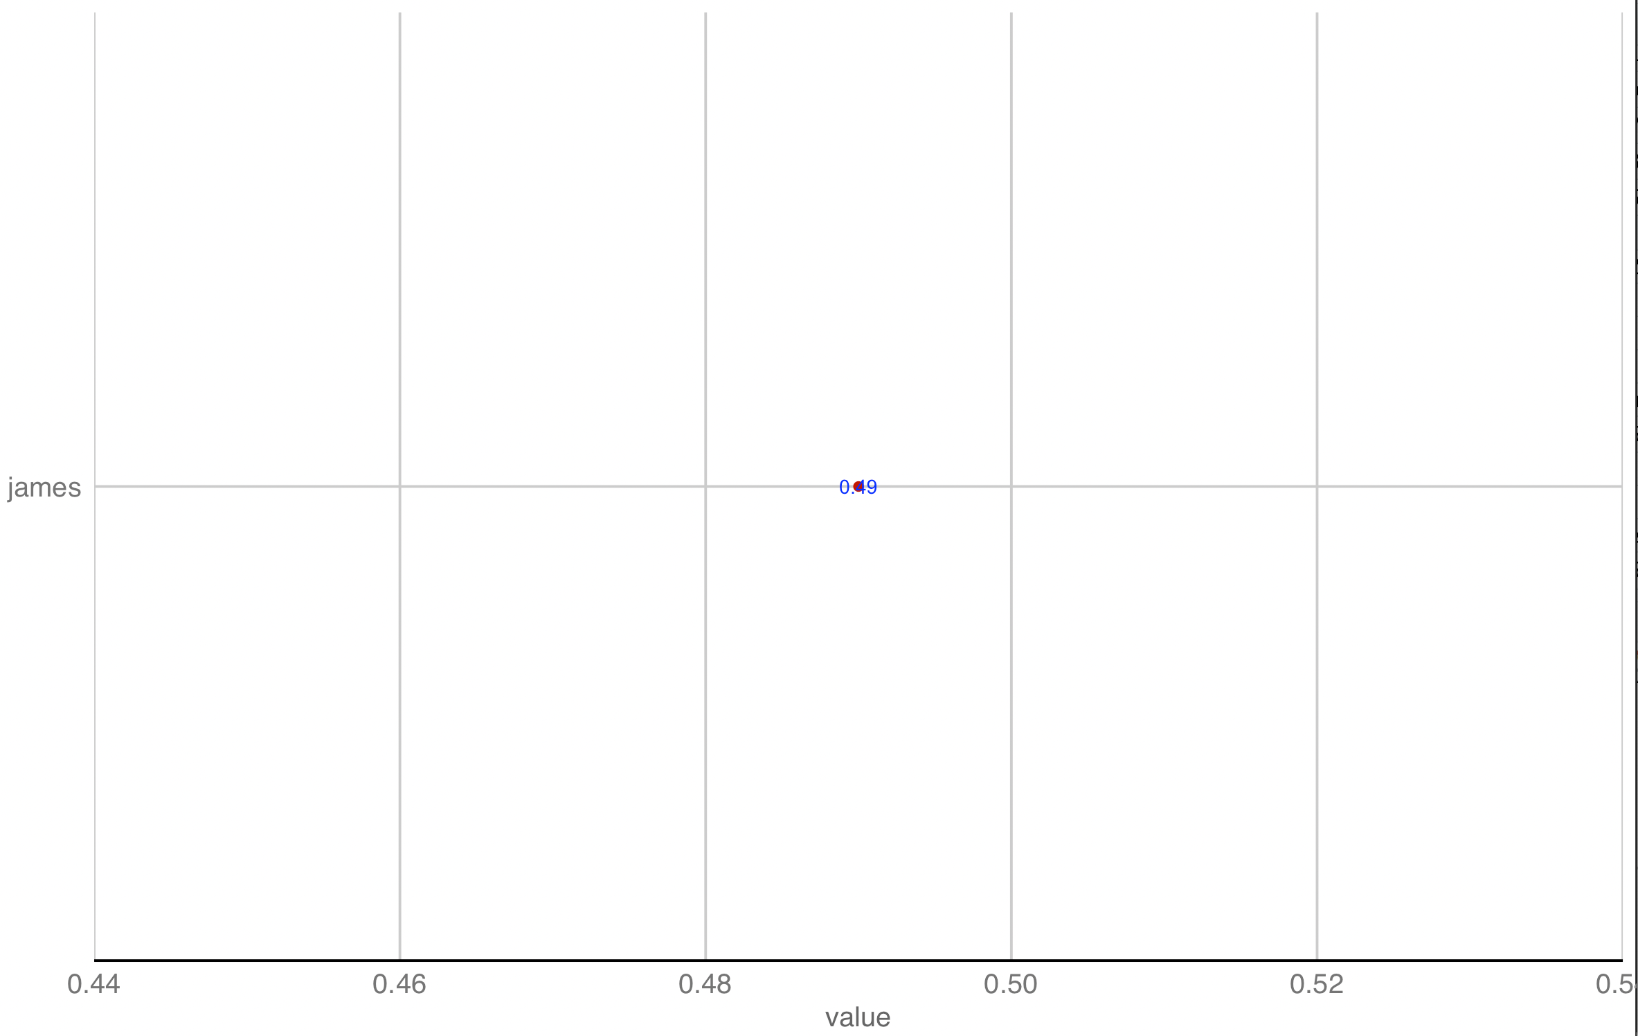
X
HIGHEST ASSOCIATION! HIS NAME ITSELF!
Lebron James

Slide 10
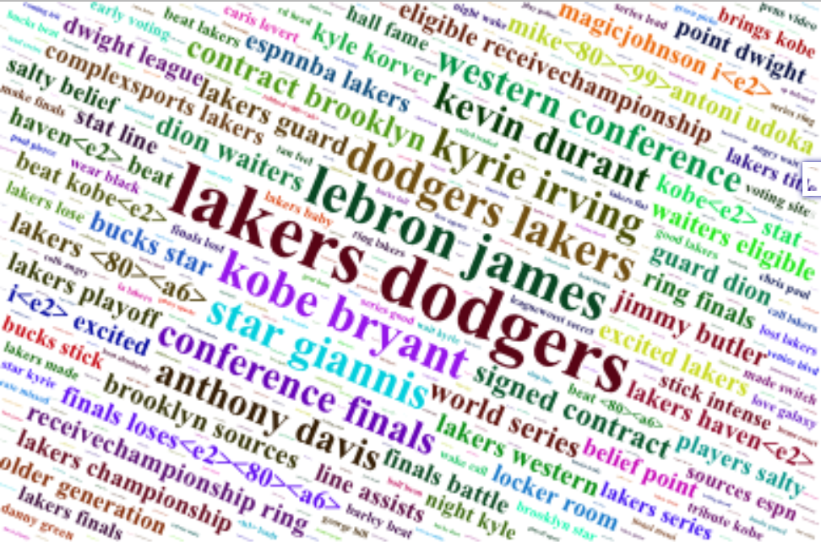
X

Slide 11
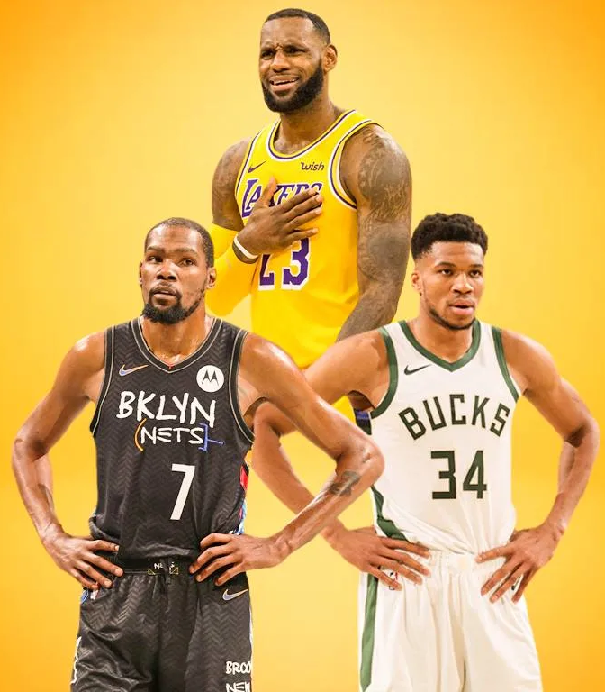
X
FUTURE
RECOMMENDATIONS –
Increase the branding capacity with Giannis Antetokounmpo.
Create more digital presence with Lebron James on social media in order to drive more traffic.
Create more digital real estate for NBA based events and promotions.
Expand the merchandise line for Giannis Antetokounmpo as he is the most popular player of the season and has the highest variety of tweets to his name.
Diversifying the promotions of NIKE targeted towards Lebron James by increasing the promotions for Kevin Durant.
Use post covid digitization to increase online presence with potential gains via NFTs, exclusive events and gaming.
Star Giannis Antetokounmpo as the annual ambassador for the upcoming year.
Target a younger audience to improve engagement and online sales

